Slide 1

RoadReady Driving App
STOP
Group
Arvind Rawat | Matthew Mahon
20368773 | 20410582
Project Advisor
Hossein Javidnia
Notes:
Hello, My name is Arvind, and this is Matthew.
Our project advisor for our final year project is Hossein

Slide 2


Introduction
Developed the driving test preparation mobile app “RoadReady” to simplify the journey from a learner to licensed driver.
App offers an intuitive platform for learning the rules and regulations of the road as well as allowing users to prepare for their theory test.
Developed with a focus on user experience, RoadReady equips learners with the tools needed for a successful test completion while instilling safe driving habits for life.
RoadReady
Driving App
Notes:
We have developed the driving test preparation mobile app called “RoadReady” which simplifies the journey for a learner to become a licensed driver. Our app offers an intuitive platform for learning the rules and regulations of the road as well as allowing users to prepare for their theory test.
We have developed the app with a focus on user experience, to ensure the learners successfully pass their theory test, while also adhering to safe driving habits for life.

Slide 3
Problem
Statement
High Failure Rates
Overall average driving pass rate is 53% (RSA)
Comprehensive learning
Existing apps offer either theory or practical driving assistance, not both.
Long Waiting Times
Leaner drivers facing long wait times for both theory/practical test
Limited Practice Resources
Lack of access to practice routes
Notes:
Before deciding on the app, we discussed some problems learners face during their driving test and theory test preparation. We mainly did this by asking a handful of students from our class and our campus. Our findings were:
High Failure Rates: With an overall average driving test pass rate of 53.2%, many learners require multiple attempts to pass, indicating a need for more comprehensive preparation tools.
Limited Practice Resources: Learners lack access to practice routes and real-time navigation for their local test centres, which are crucial for practical test preparation.
Comprehensive Learning Approach: Existing apps offer either theory or practical driving assistance, not both, leaving a gap for an all-in-one solution.
Long Waiting Times: Learner drivers often face long waiting times for both theory and practical driving tests, leading to delays in obtaining a license.

Slide 4
Solution Overview
Integrated Learning
RoadReady combines theory test preparation with practical driving tools
Real-Time Navigation
upcoming live navigation feature will allow learners to practice on actual test routes
Comprehensive Content
Vast database of practice questions, mock exams, and real-time navigation
Efficiency and Convenience
RoadReady minimizes the impact of long waiting times, allowing learners to make most of their time at home.
Notes:
To solve the issues learners face during the preparation for their driving and theory test we propose the following:
Integrated Learning: RoadReady combines theory test preparation with practical driving tools, offering an all-in-one platform that caters to both aspects of driver education.
Comprehensive Content: With a vast database of practice questions, mock exams, and real-time navigation, our app ensures learners are thoroughly prepared, aiming to increase the driving test pass rate.
Real-Time Navigation: The upcoming live navigation feature will allow learners to practice on actual test routes, providing a realistic experience and reducing the need for repeated practical tests.
Efficiency and Convenience: By facilitating at-home study and route practice, RoadReady minimizes the impact of long waiting times, allowing learners to make the most of their preparation period. RoadReady not only fills the current market gap but also empowers learners with the knowledge and confidence needed to pass their driving tests and become safe, responsible drivers.

Slide 5
Market for RoadReady
Smartphone users:
As of 2023 there are 3.99 million smartphone users in Ireland [1]
Theory test conducted:
The Driver Theory Testing Service conducted that in 2022 it received 201,915 tests with a 53.2% pass rate for learners.
Learner Permits:
In 2016, there were 249,647 drivers holding only learner permit licenses [2].
60,000 of those drivers were waiting for their driving test last year [3].
Summing our primary and secondary research we evaluated our target market to be around 300,000 users
Notes:
When conducting secondary research, we discovered that as of 2023 there almost 4 million smartphone users in Ireland.
In 2022 the Driver Theory Testing Serviced received over 200,000 tests with a pass rate of 53%.
In 2016 there were almost 250,000 drivers holding a learner permit. 60,000 of those drivers were waiting for their driving test last year.
This means those that are waiting would most likely quite active in trying prepare for their driving test.
We also conducted primary research which was just us asking 12 people about our prosed idea. Summing our primary and secondary research, we evaluated our target market to be around 300,000 users.

Slide 6
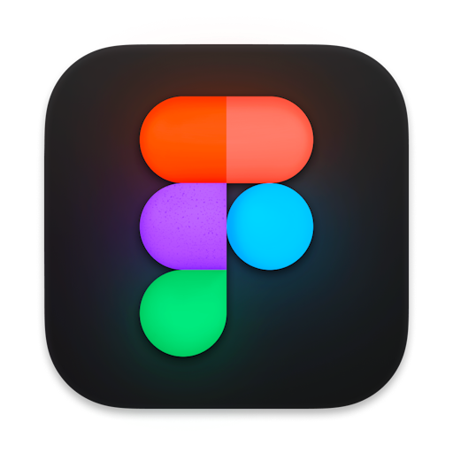




Technology Stack
Technologies and tools used in app development:
Figma – Create UI designs
React Native – Frontend development and UI
Locofy AI – Convert UI designs to usable react
Firebase – Database, Database Management, and Authentication
Expo Go – Testing, Emulating, and to allow for quick development
React Native
Figma
Firebase
Locofy AI
Expo Go
Notes:
The technologies we used in the app development were:
Figma – To Create UI designs
Locofy AI – Convert UI designs to usable react native code
React Native – for the Frontend development and UI
Firebase – Database, Database Management, and Authentication
Expo Go – Testing, Emulating, and to allow for quick development

Slide 7
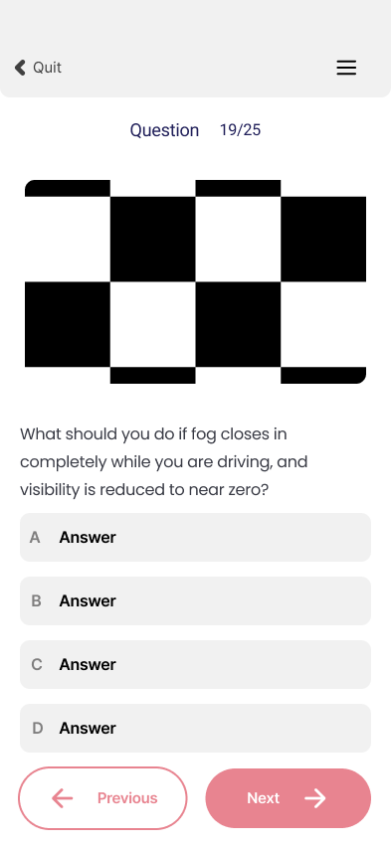
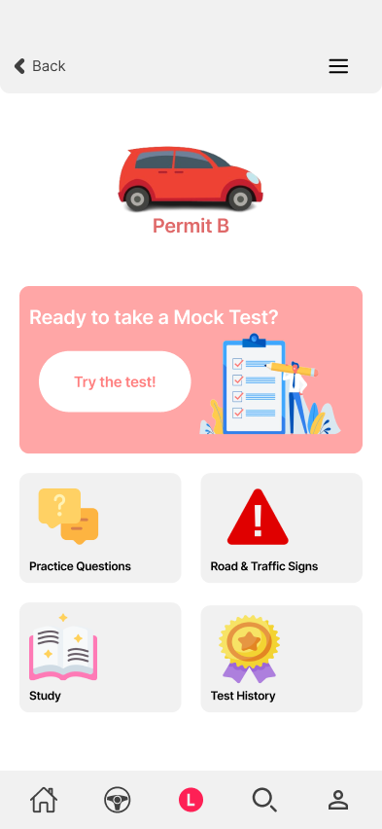
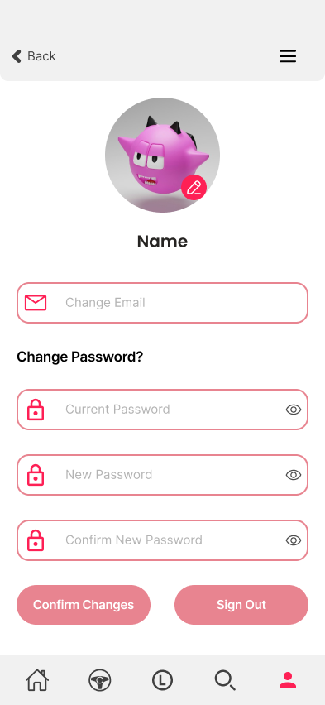
Figma
Used Figma to firstly design our app’s pages.
Carefully used auto-layout
Used components
Selected the font styles/colours
Notes:
We used Figma design tool to firstly design our app’s pages. To do this we carefully, used auto-layout which is something we applied our web page knowledge from. We used components for elements that we were re-using. This saved us from writing the same code.
We also selected the font styles and colors which were mainly made up of light red’s and black.

Slide 8
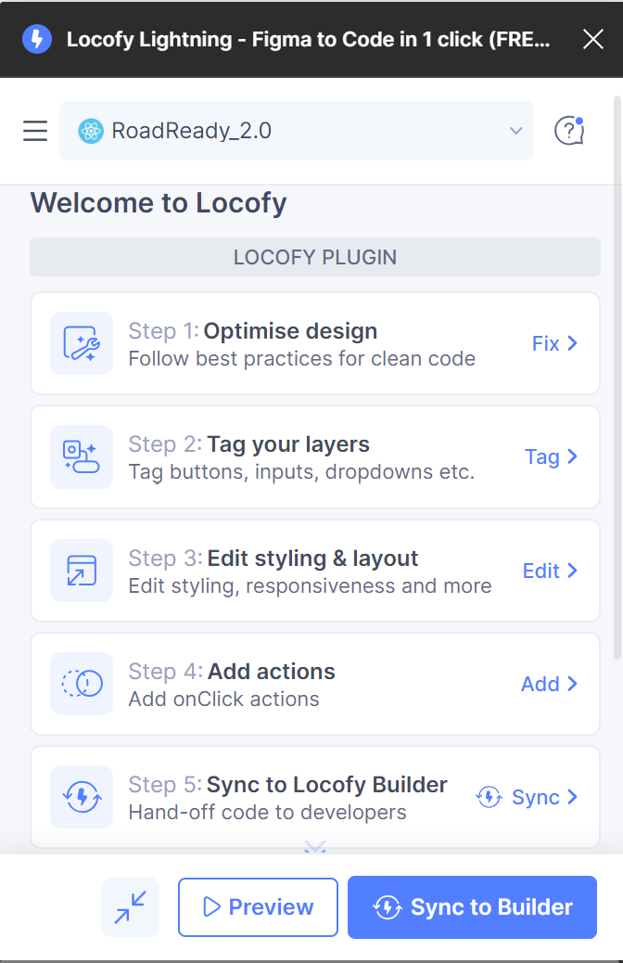
Locofy
Used Locofy plugin to covert UI design to a working React native code
Tagged our layers e.g. buttons, inputs etc.
Then added actions e.g. onClick do something
Notes:
We used a built-in plugin called Locofy which is an ai tool that converts UI to React Native. To do this we tagged our layers such as the buttons, inputs etc. We then added actions for example onClick go to the homepage.

Slide 9
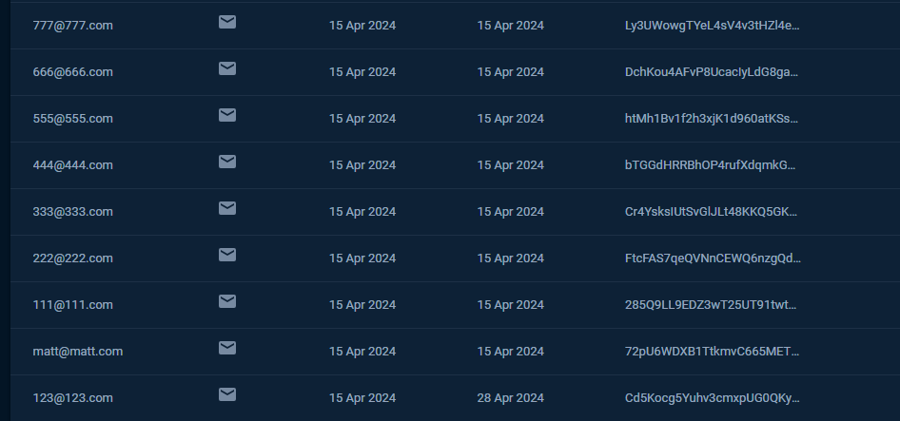
Firebase
Used Firebase to read, write and delete our data.
Firebase was also used to authenticate Users to the app.
This allowed Users to create accounts to have a personalized experience.
This prevents Users from accessing other accounts and creating duplicate accounts.
Allows us to store data and update it.

Slide 10
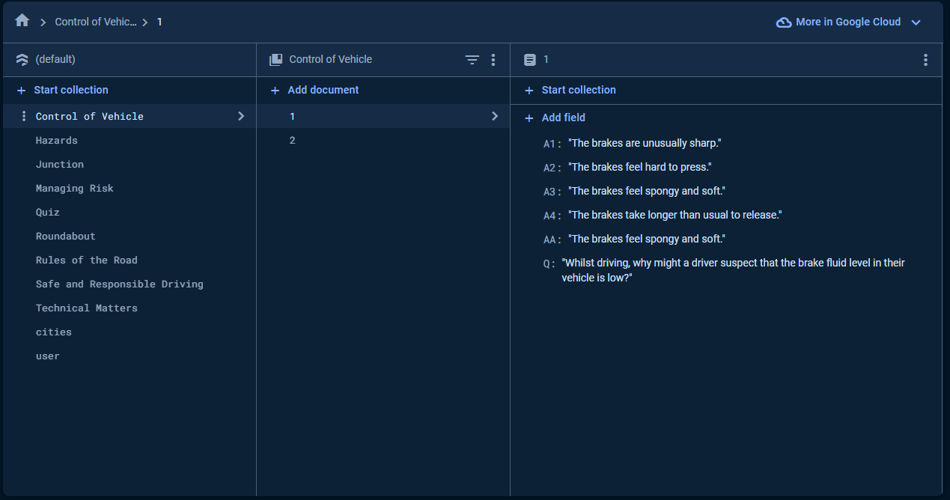
Database Schema

Slide 11

React Native
We used React Native to establish the app environment and create the functionality of the app.
We used React Native as it supports both IOS and Android development.
React Native allowed us to use React Hooks to aid in the development such as useState and useEffect.

Slide 12
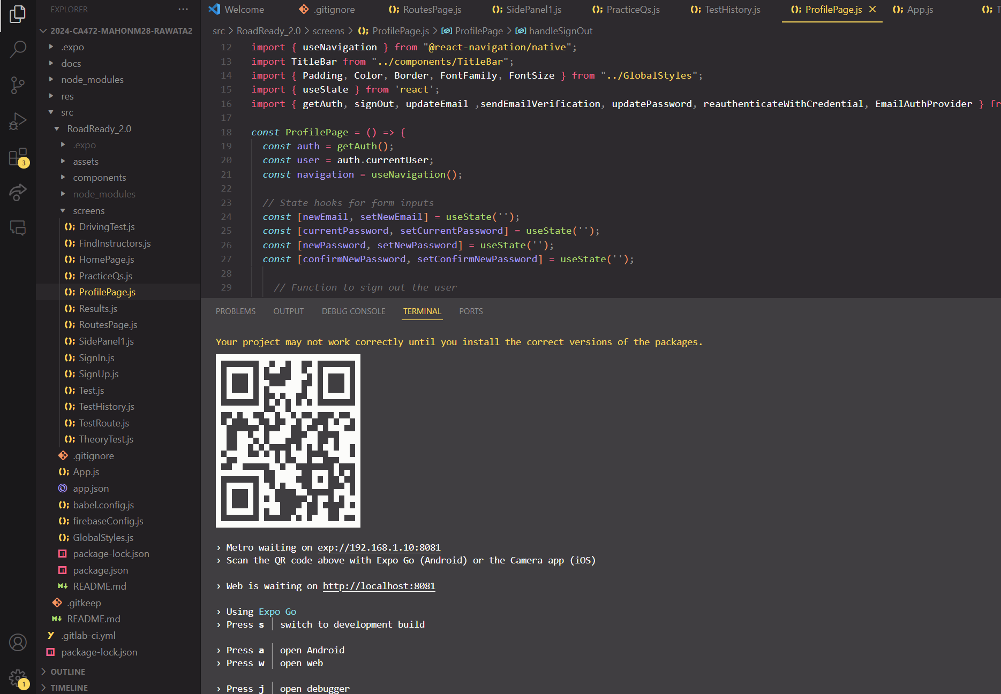
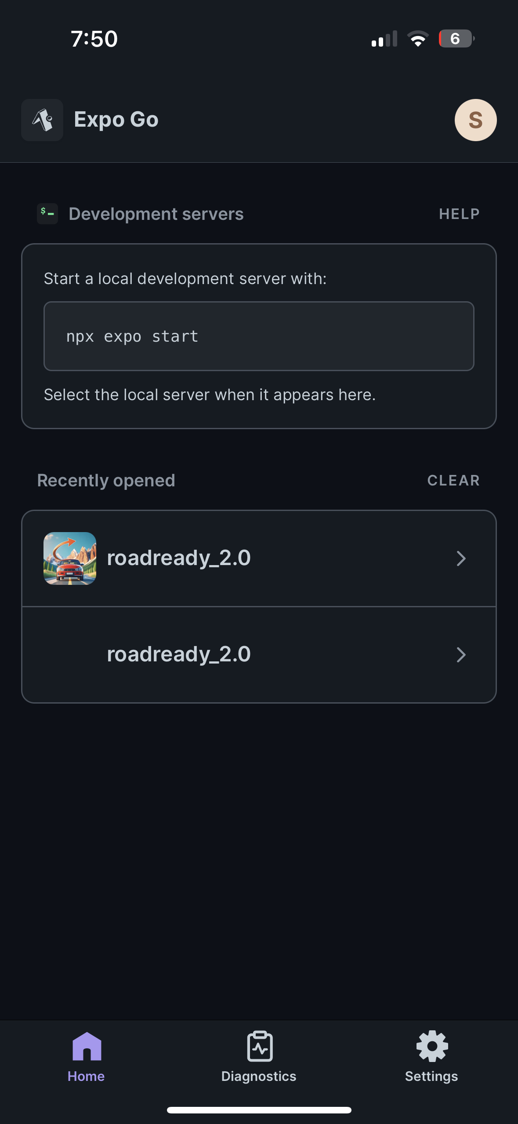
Expo Go
Finally, after cleaning/improving our code from visual studio IDE we used Expo Go App on our phones to see our app in action
Ran npm start
Generated a QR code for mobile
Press w to open webpage

Slide 13
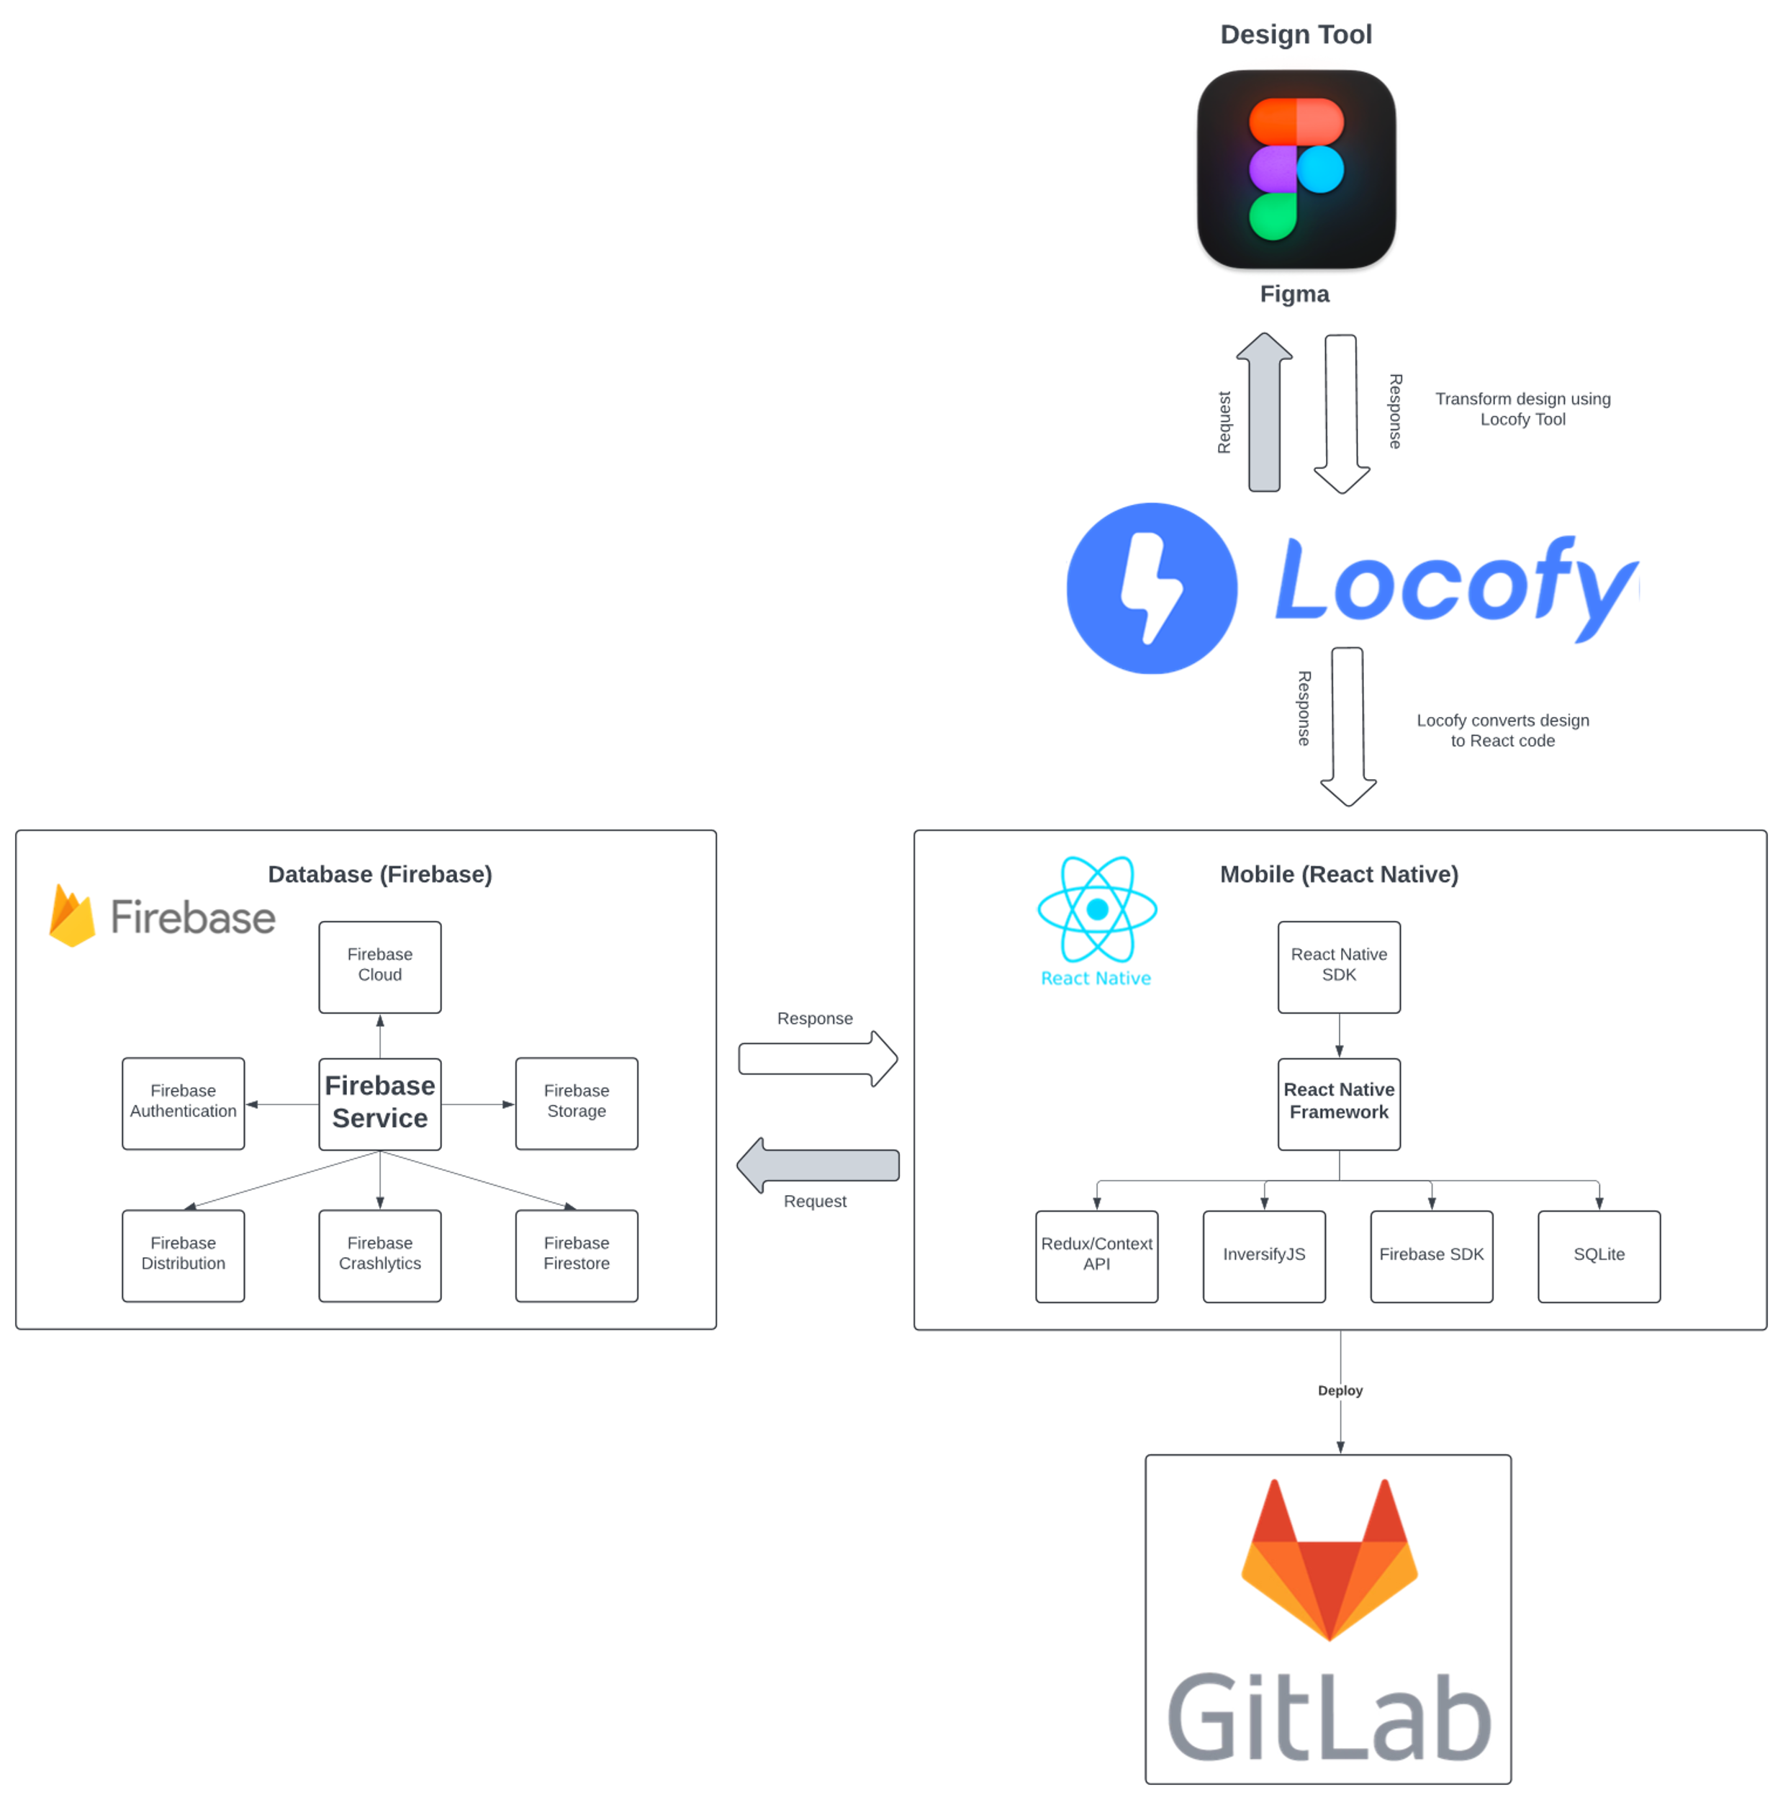
Software Architecture
Notes:
This is our software architecture for our app, as you can see:
We firstly use Figma to create our UI designs.
We then use Locofy Plugin which sends a request to Figma to use the design for code conversion.
Upon doing so we successfully create a useable react native code. Its framework consists of JS as well as Sqlite and more.
We then Intergrate our Firebase DB which does the user authenticate and populates the images/files for the theory test questions.
It then sends a response back to React.
When we are happy with our code, we deploy it straight to Gitlab
Lastly, we don’t mention this in our software architecture, but we use Expo Go to test our app on our actual phones

Slide 14
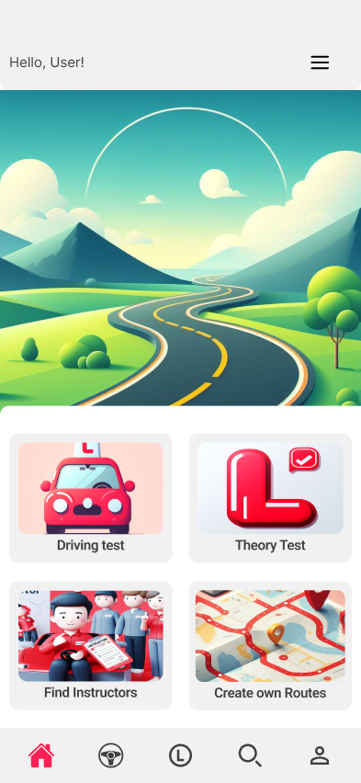
App’s Main Features
1
2
Theory Test
Performance Tracking
The core feature that offers a comprehensive set of practice questions and mock exams to help users prepare for the theory test.
records users’ scores and progress over time, providing insights into their strengths and areas for improvement.
3
4
User Profile Management
Educational Resources
Allows users to create and manage their profiles, including updating personal details and managing account settings.
Direct links to official RSA resources and guidelines, ensuring users have access to accurate and current information.
Notes:
the current functionality we have in our app is as follows:
Theory Test Preparation: This core feature we have in our app that offers a full set of practice questions and mock exam to help users prepare for the theory test.
Performance Tracking: is a feature that records users’ scores and progress over time.
User Profile Management: Allows users to create and manage their profiles, including updating email and password.
4. Educational Resources: Direct links to official RSA resources and guidelines, ensuring users have access to accurate and current information.

Slide 15

Challenges during
Development
Problems with exporting UI converted code from Locofy
Firebase DB could only handle a max of 50k reads in the free version per day
Time constraints – felt a bit overwhelmed due to other projects/assignments
Notes:
The challenges we encountered during the development were:
1) When exporting the converted UI code from Locofy, some UI elements for example buttons and menus did not work or show up properly.
we fixed those issues in visual studio before deployment.
2) The free version of Firebase Database could only handle a max of 50k reads per day which meant we could not view the prototype
To get around this issue we tried to only view the app when a screen was complete and ready for deployment
3) Time constraints: We felt a bit overwhelmed due to other projects/assignments we had to work alongside our final year project

Slide 16
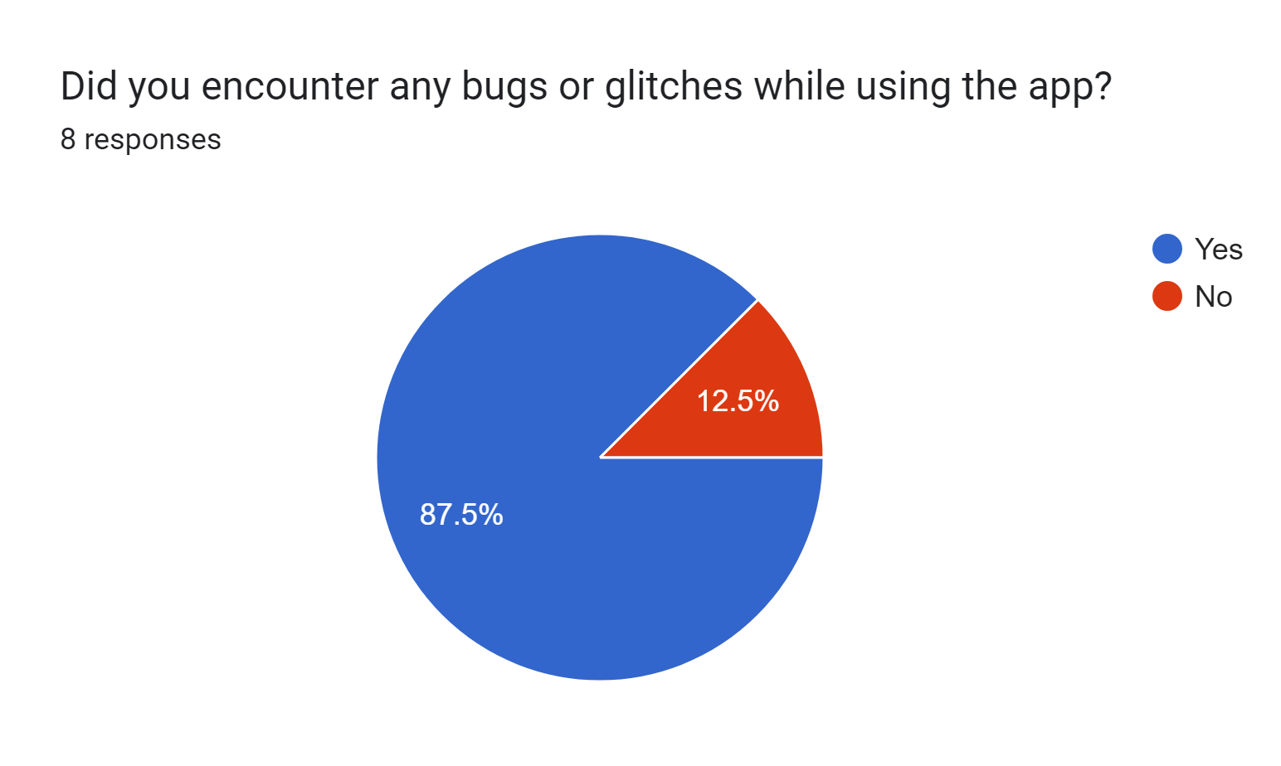
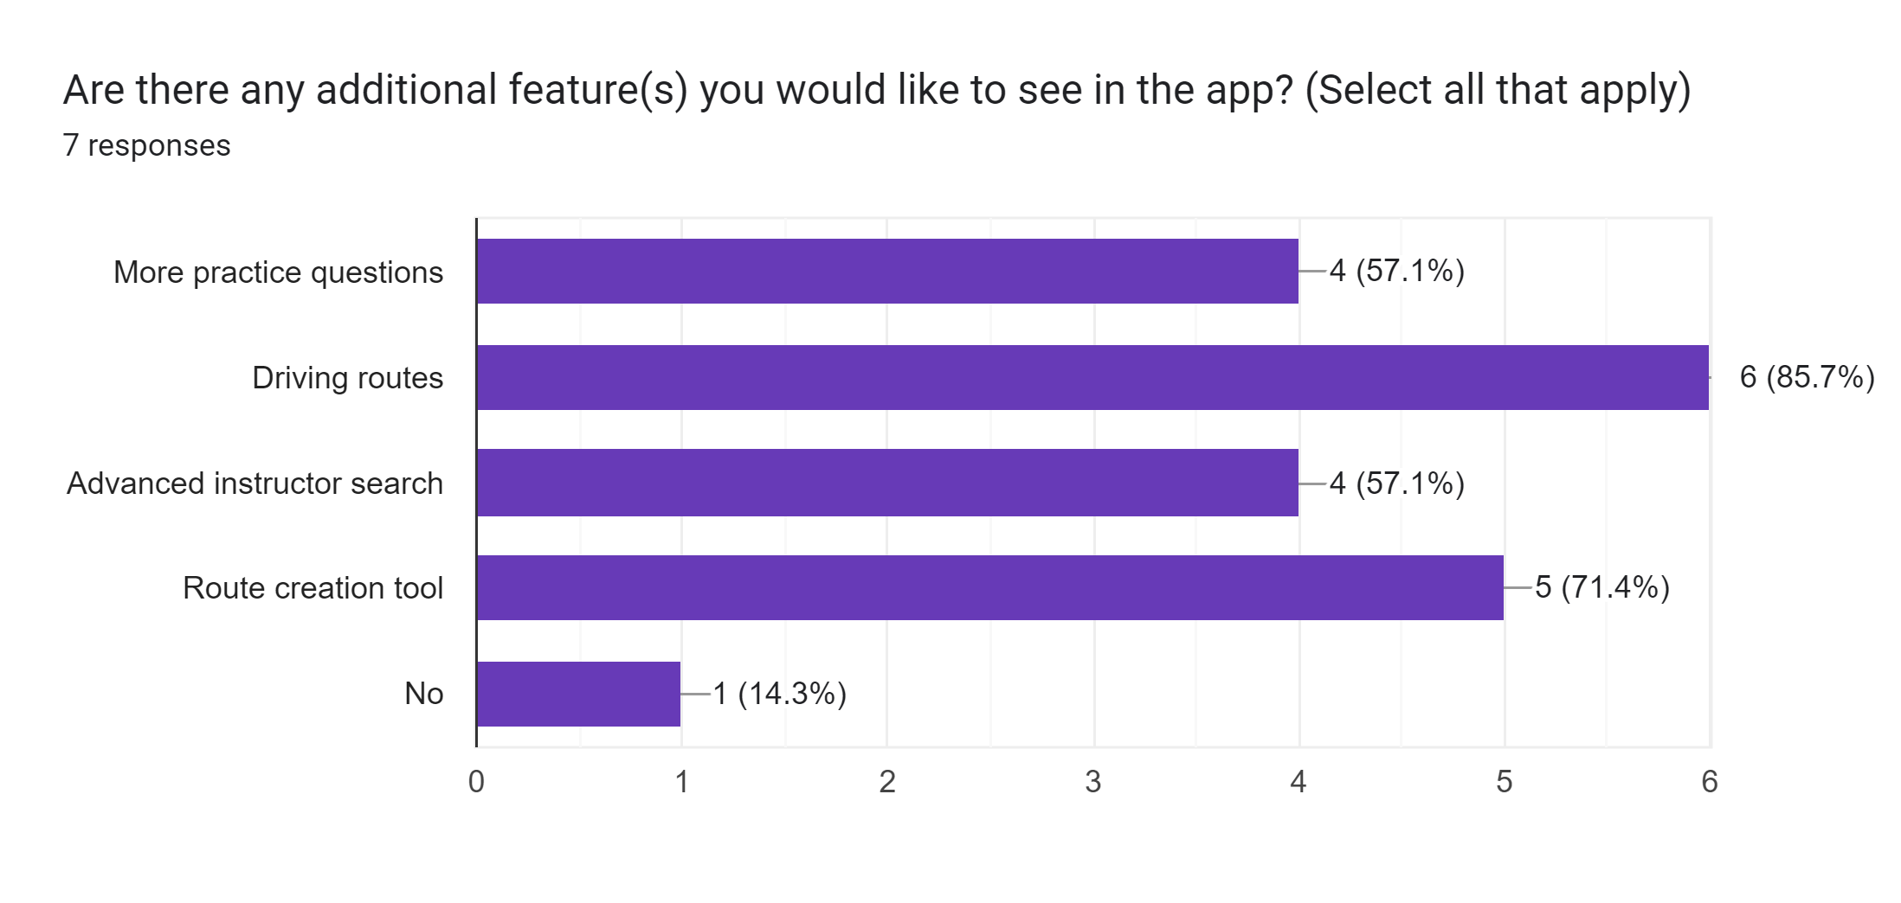
Testing & User Feedback
Testing
Users were asked to test the app.
Bugs were found and fixed.
Corrections were made to existing features.
User Feedback
We then asked Users to give feedback on:
Potential Improvements
Additional Features
Their overall experience with the app.
Notes:
For Testing we asked Users to do User Testing.
This resulted in finding bugs which we could then resolve and corrections to existing features.
We then asked the Users to give us feedback on:
Potential Improvements
Additional Features
Feedback on their overall experience with the app

Slide 17
Subscription Price List
Freemium Plan
Premium Plan (Quarterly)
Premium Plan (Yearly)
Access to all theory Qs
Limited no. of predefined routes
Ads
Email support
All features from premium including “create your own routes”
Ad-free
Priority email and chat support
All features, including all predefined routes
Ad-free
Priority email and chat support
FREE
€10/three months
€35/year
Notes:
We have 3 pricing models for users:
Freemium plan which gives the user access to:
All theory Q's
Limited no. Of routes
Email support
But this plan comes with ads
The Premium Quarterly Plan:
€10 every 3 months
It comes with all features and routes
Ad free
Priority email and chat support
The Premium Yearly Plan:
€35 per year
All features and routes with additional feature to create routes
Ad free
Priority email and chat support

Slide 18

Future Roadmap
Feature Completions
Driving Test Routes
Route Creation (MapBox)
Instructor Finder.
User Feedback
Get constant feedback to plan for future features or improvements
Feature Improvements
Learning Materials
Profile Customisation
Progress Tracking
Feature Changes
Instructor Login
Instructor Route Creation
User desired changes
Upcoming Features
Instructor Rating
Route Sharing
Route Rating

Slide 19
Technical Foundations
UI/UX
CA357 User Interface Design and Implementation
Firebase Database
CA227 Business Database Management
Software Testing
CA358 Software Testing
CA4004 Soft. Eng: Process, Principles & Methods
Notes:
These are some of the modules from where we applied our knowledge:
User Interface Interface and experience from User Interface Design Module
Firebase from Business Database management module
And software testing from the software testing and software engineering modules

Slide 20
Individual Contribution
Arvind
Worked primarily on the frontend, UI/UX, implementing Figma Designs using Locofy and sharing React code with Matthew.
Matthew
Worked primarily on the backend, app development, user authentication, integrating Firebase DB to React and cleaning code from Locofy.
Software Architecture was discussed and advised by Hossein, our project advisor, who gave us the green light.

Slide 21
References
[1] Murphy, E. (2023). Over 1,700 drivers in Ireland operating on learner permits for over 30 years. [online] Irish Mirror.Available at: https://www.irishmirror.ie/news/irish-news/shock-over-1700-drivers-ireland-30399907;
White, J. (2023). Almost 60,000 learner drivers face 10-month wait for tests. [online] Irish Examiner. Available at: https://www.irishexaminer.com/news/arid-41133487.html [Accessed 17 Oct. 2023].
[2] RSA.ie. (n.d.). Education - Road safety awards. [online] Available at: https://www.rsa.ie/road-safety/statistics [Accessed 17 Oct. 2023].
[3] www.cso.ie. (n.d.). Driver and Vehicle Testing - CSO - Central Statistics Office. [online] Available at: https://www.cso.ie/en/releasesandpublications/ep/p-tranom/to2016/dvt/#:~:text=A%20total%20of%202%2C820%2C528%20Irish [Accessed 19 Oct. 2023].
[4] White, J. (2023) One year to cut driving test wait times to 10 weeks, Irish Examiner. Available at: https://www.irishexaminer.com/news/arid-41114116.html [Accessed: 24 October 2023]
React Native. [online] Available at: https://reactnative.dev [Accessed 19 Oct. 2023].
Google (2019). Firebase. [online] Firebase. Available at: https://firebase.google.com [Accessed 19 Oct. 2023].
Expo. (n.d.). Expo. [online] Available at: https://expo.dev/client [Accessed 19 Oct. 2023].
Laura Ceci and 25, A. (2023) Average price of Android and IOS apps 2018, Statista. Available at: https://www.statista.com/statistics/262387/average-price-of-android-ipad-and-iphone-apps/ [Accessed: 13 October 2023].

